Slide 1
Chapter 17
GRASP Design Patterns:
Designing Objects with Responsibilities

Slide 2
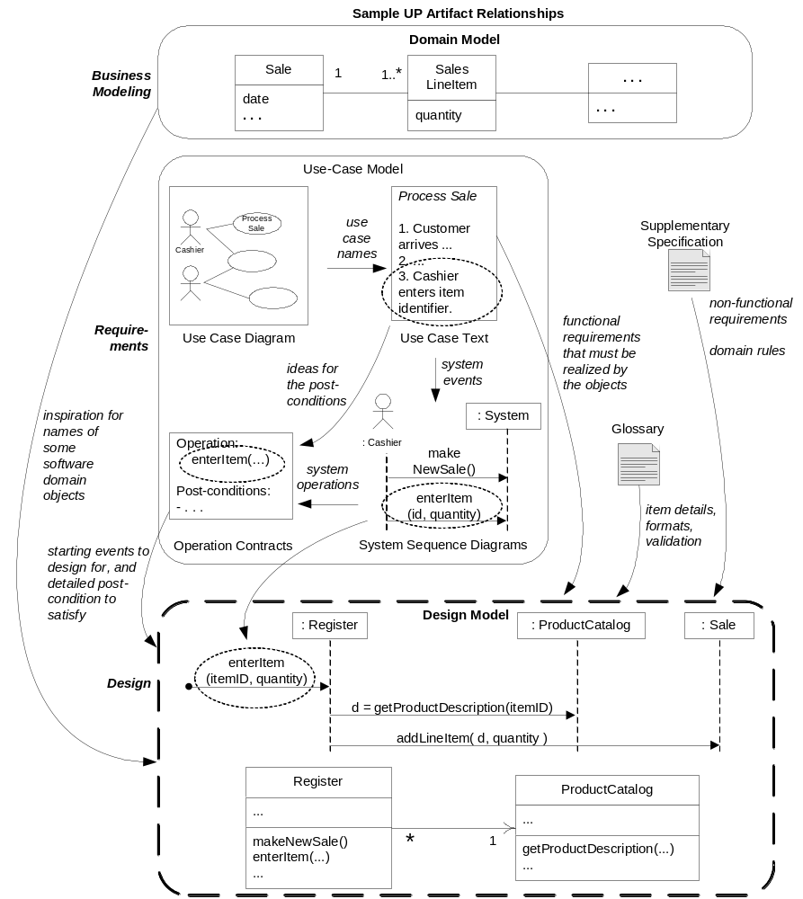

Slide 3
Responsibility-Driven Design (RDD)
A way of thinking about OOD:
  In terms of
    Responsibilities
    Roles
    Collaborations
Common responsibility categories:
  Doing:
    Doing something itself:
      Creating and object or doing a calculation
    Initiating action in other objects
    Controlling and coordinating activities in other objects
  Knowing:
    Knowing about private data
    Knowing about related objects
    Knowing about things it can derive or calculate
Bigger responsibilities may take several classes
Guideline:
  Domain model helps with “knowing”
  Interaction diagrams help with “doing”

Slide 4
RDD and Collaboration
Responsibilities implemented by methods
Some methods act alone and do a job
Some collaborate with other objects and methods
  Example: Sale class has getTotal() method
  Sale and getTotal() collaborate with other objects to fulfill a responsibility
    SalesLineItem objects and getSubtotal() methods
RDD: Community of collaborating objects

Slide 5
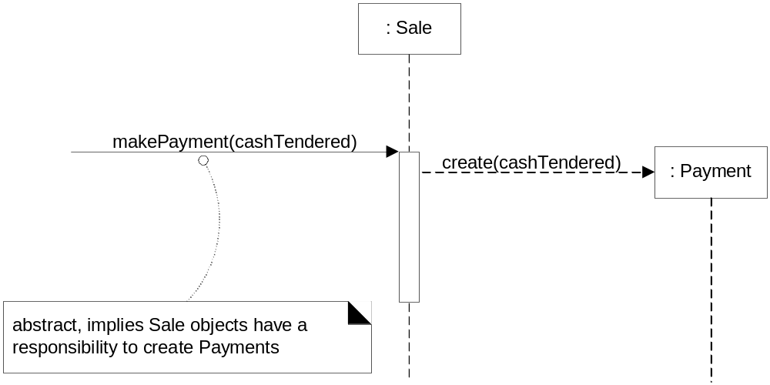
RDD and Interaction Diagrams
We decide on responsibility assignment when drawing interaction diagrams

Slide 6
Patterns
Patterns: A repertoire of
  general principles
  idiomatic solutions
to guide us in the creation of software
A pattern: A named and well-known problem/solution pair that
  Can be applied in new contexts
  With advice on how to apply it in novel situations
  With a discussion of its trade-offs, implementations, variations, …
Names facilitate communication about software solutions
Some patterns may seem obvious: That’s a good thing!

Slide 7
Pattern Example
Pattern name
Problem:
Solution
Information Expert
What is a basic principle by which to assign responsibilities to objects?
Assign a responsibility to (one of?) the class that has the information needed to fulfill it

Slide 8
Well-known Pattern Families
GRASP:
  General Responsibility Assignment Software Patterns
    (or Principles)
  9 Patterns
GoF: Design Patterns: Elements of Reusable Object-Oriented Software
  GoF:
    Erich Gamma
    Richard Helm
    Ralph Johnson
    John Vlissides
  23 patterns
  Some of these will be covered

Slide 9
GRASP Patterns
Creator
  Who creates?
Information Expert
  Who, in the general case, is responsible?
Low Coupling
  Support low dependency and increased reuse
Controller
  Who handles a system event?
High Cohesion
  How to keep complexity manageable?
Polymorphism
  Who, when behavior varies by type?
Pure Fabrication
  Who, when you are desperate, and do not want to violate High Cohesion and Low Coupling?
Indirection
  Who, to avoid direct coupling?
Law of Demeter (Don’t talk to strangers)
  Who, to avoid knowing about the structure of indirect objects?

Slide 10
The “Creator” Pattern
Example: Monopoly game
  See domain model example
Problem: Who creates the Square object in a Monopoly game?
  Java answer: Any object could
  Common answer: Make Board create Square objects
Is this good design?
  Intuition: Containers should create the things contained in them
  Issue: No classes yet, only have the domain model
  Look at the domain model for inspiration to pick the first important software classes

Slide 11
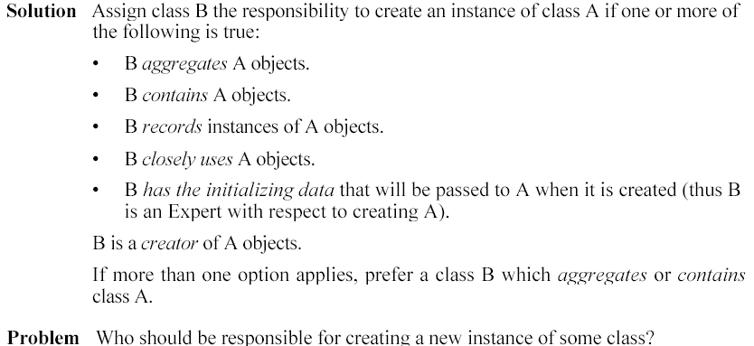
The Creator Pattern

Slide 12

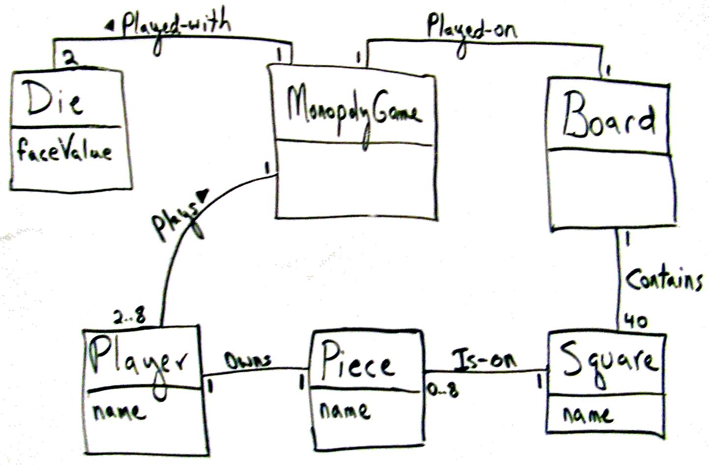
Monopoly Iteration-1 Domain Model (Again)

Slide 13
The “Information Expert” of “Expert” Pattern
Problem: Given the name of a Monopoly square, we want to get a reference to the Square object with that name
  Most developers would choose the Board object to do this job
  Intuition:
    A responsibility needs information for its fulfillment
      Info about other objects,
      an object’s own state
      The world around an object
      information an object can derive
  The object that will do the job must know all Squares
  Board has the information necessary to fulfill the responsibility

Slide 14
The “Information Expert” Pattern
Name
Problem:
Solution (advice):
Information Expert or
Expert
What is a basic principle by which to assign responsibilities to objects?
Assign a responsibility to the class that has the information needed to fulfill it

Slide 15
The “Low Coupling” Principle
Name
Problem:
Solution (advice):
Low Coupling
How to reduce the impact of change on software?
Assign responsibilities so that (unnecessary) coupling remains low. Use this principle to evaluate alternatives.

Slide 16
Evaluating the Effect of Coupling
Coupling: A measure of how strongly one element is connected to, has knowledge of, or depends on other elements
The greater the coupling, the greater the dependence between objects
  Coupling is avoided because it goes against OO principles
Why is low coupling good?
It reduces time, effort and defects involved in modifying software
The “Expert” pattern supports low coupling

Slide 17
The “Controller Pattern”
Question: What first object after or beyond the UI layer should receive the message from the UI layer?
  Assign the responsibility for handling a system event message to a class representing one of these choices:
  The business or overall organization (a façade controller).
  The overall "system" (a façade controller).
  An animate thing in the domain that would perform the work (a role controller).
  An artificial class (Pure Fabrication) representing the use (a use case controller).

Slide 18
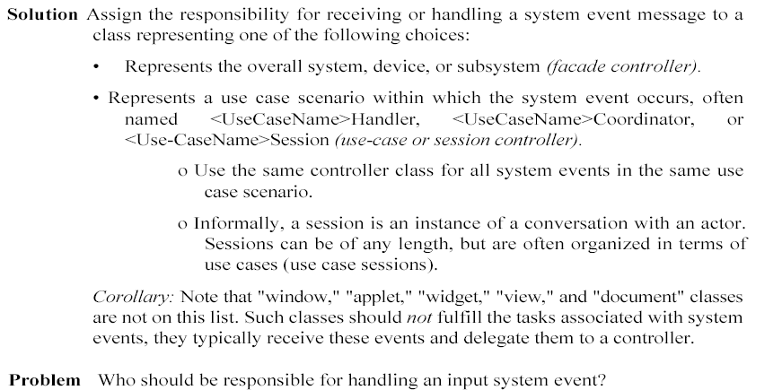
The “Controller” Pattern

Slide 19
Monopoly Controller Alternatives
Option 1: Represents the overall “system” or a “root object”
  An object called MonopolyGame
Option 2: Represents a device that the software is running within
  It doesn’t really apply here.
  It applies to designs with specialized hardware devices: Phone, BankCashMachine, …
Option 3: Represents the use case or session.
  The use case that the playGame system operation occurs in is called Play Monopoly Game
  A class such as PlayMonopolyGameHandler (or ...Session) might be used
The very first option looks good if there are only a few system operations

Slide 20
High Cohesion
Cohesion:
  How are the operations of a software element functionally related?
  How much work is a software element doing?
Example:
  The “Big” class: 100 methods, 2000 lines of code
  The “Small” class 10 methods, 200 lines of code.
  “Big” is probably covering many different areas of responsibility
    Examples: database access AND random number generation
  Big has less focus or functional cohesion than small
An object that has too many different kinds of responsibilities probably has to collaborate with many other objects
  Low cohesion → High coupling, Both bad.

Slide 21
The “High Cohesion” Principle
Name:
Problem:
Solution (advice):
High Cohesion
How to keep objects focused, understandable, and manageable, and as as side effect, support low coupling?
Assign responsibilities so that cohesion remains high. Use this to evaluate alternatives.

Slide 22
A more detailed look at “Creator”
Problem: Who should be responsible for creating a new instance of some class.
Solution: B should create an instance of A if
  B “contains” or compositely aggregates A
  B records A
  B closely uses A
  B has the initializing data for A that will be passed to A when it is created. Thus, B is an Expert with respect to creating A.
If more than one of the above applies, prefer a class B which aggregates or contains A.

Slide 23
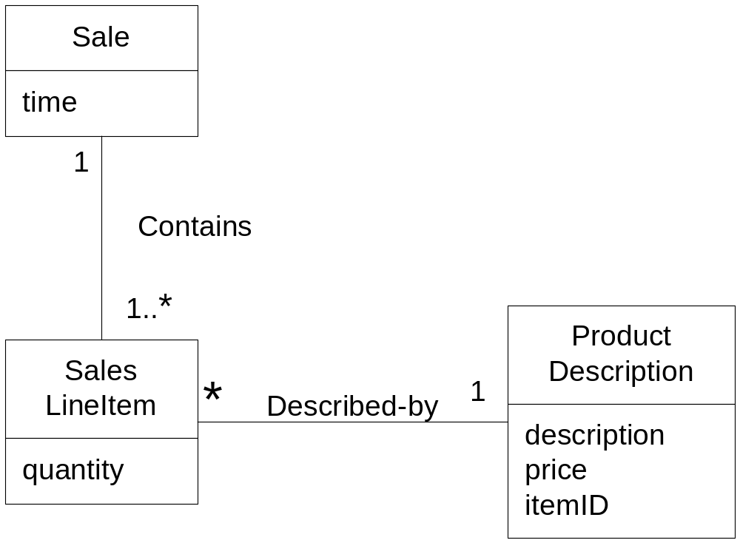
Partial Domain Model
Basic intent of the “Creator” pattern:
Find a creator that needs to be connected to (dependent on or associated with) the created object anyway. Supports low coupling.

Slide 24
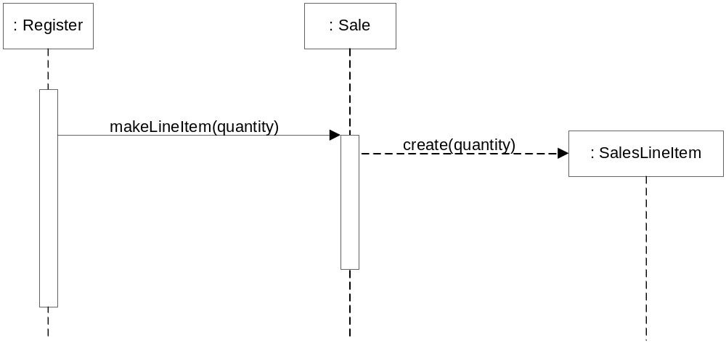
Creating a SalesLineItem object

Slide 25
The “Creator” pattern
Another use: Identify a creator by looking for a class that has the initialization data that will be passed in during creation.
  Actually an example of the “Expert” pattern
Initialization data passed in to an “initialization method”
  Often a constructor with parameters
  Or a factory method
Example:
  A Payment instance, when created needs to be initialized with the Sale total.
  Sale knows Sale total. Good candidate for creating Payment.

Slide 26
Information Expert
Problem: What is a general principle of assigning responsibilities to objects?
Solution: Assign a responsibility to the information expert
  The information expert: The class that has the information to fulfill the responsibility
Guideline: Start by clearly stating the responsibility
  Example: Who should be responsible for finding out what checker is located at a given coordinate on the board?

Slide 27
Information Expert
Question: Where do we look to analyze the classes that have the info needed?
  The Domain Model? Or,
  The Design Model (class and interaction diagrams)

Slide 28
Information Expert
Question: Where do we look to analyze the classes that have the info needed?
  The Domain Model?
  The Design Model (class and interaction diagrams)?
Answer:
  If there are relevant classes in the Design Model, look there first
  Otherwise, look in the domain model. Use it to inspire the definition of new Design classes.

Slide 29
Applying the “Information Expert” Pattern
What information do we need to determine the grand total of a Sale?
  All the SalesLineItem instances
  Sum of their subtotals
A Sale instance contains these
  By “Information Expert”, it is a suitable class for
  computing the grand total

Slide 30
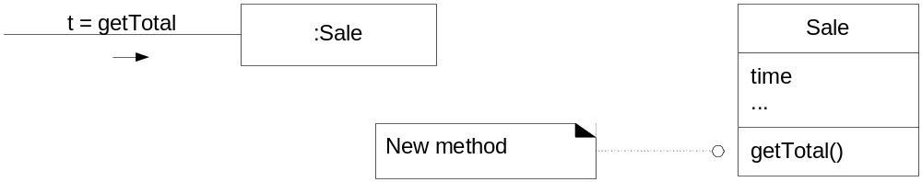
Applying Information Expert

Slide 31
Applying Information Expert (cont’d)
Next question: What information do we need to know to determine the line item subtotal?
  Answer: SalesLineItem.quantity and SalesLineItem.price
Question: Who knows these?
  Answer: SalesLineItem
  By “information expert”, SalesLineItem should compute the subtotal

Slide 32
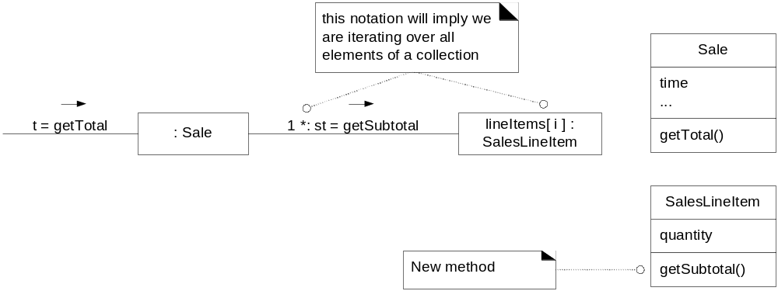
Applying Information Expert (cont’d)

Slide 33
Applying Information Expert (cont’d)
Next issue: Who should return the price of an item?
  Who knows the price of an item?
    ProductDescription
  By “information expert”, SalesLineItem asks ProductDescription to return the price.

Slide 34
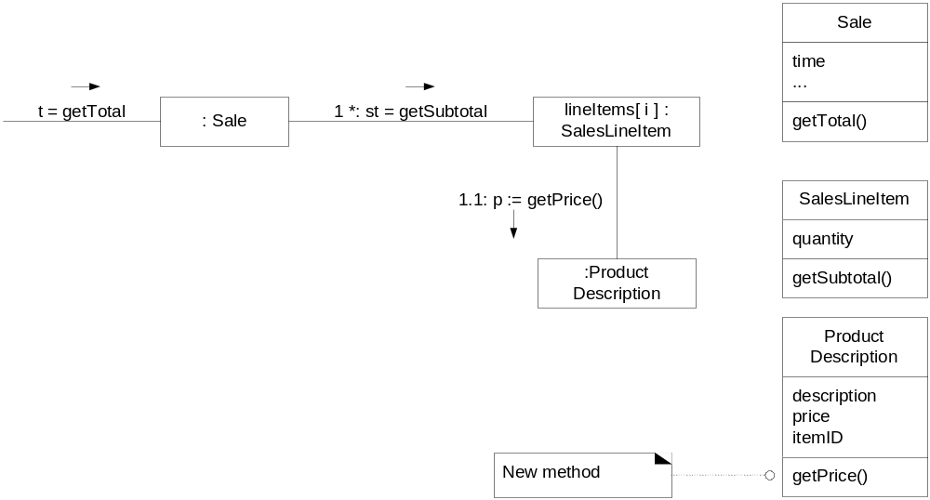
Applying Information Expert (cont’d)
Lesson learned: Many partial information experts collaborate in a task

Slide 35
Warning: Don’t blindly apply “Information Expert”
Example:
  Who should be responsible for saving a Sale in a database?
    Sale has all the information that needs to be saved
  But acting on this alone leads to problems in cohesion, coupling, and duplication
  Sale class must now contain logic related to database handling
    SQL, JDBC, ...
  Many other objects that need to be stored will duplicate the “saving” code

Slide 36
Low Coupling
Problem: How to support low dependency, low change impact, and increased re-use?
Why is a class with high (or strong) coupling bad?
  Forced local changes because of changes in related classes
  Harder to understand in isolation
  Harder to re-use
    Because it requires the presence of classes that it depends on
Solution:
Assign responsibilities so that coupling remains low.
Important: Use this principle to evaluate alternatives

Slide 37
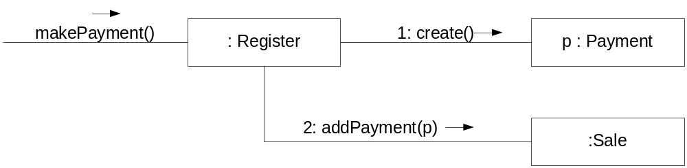
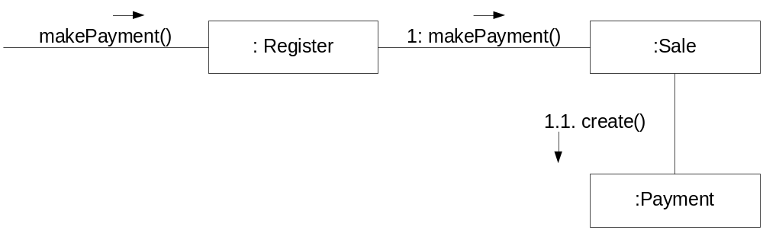
Two alternative responses to “Who creates Payment?”

Slide 38
Two alternative responses to “Who creates Payment?”
The second alternative leads to
less coupling
  Avoids an association between
  Register and Payment
  Sale and Payment already related

Slide 39
Common Forms of Coupling from Type X to Type Y
TypeX has an attribute that refers to a TypeY instance, or TypeY itself
A TypeX object calls on services of a TypeY object
TypeX has a method that references:
  an instance of TypeY
  TypeY itself (static method call, etc.)
    Typically occurs when an argument, return value or a local variable of TypeX is type TypeY
TypeX is a direct or indirect subclass of TypeY
TypeY is an interface, and TypeX implements that interface

Slide 40
Guidelines
A subclass is VERY strongly coupled to its superclass
  Think carefully before using inheritance
Some moderate degree of coupling between classes is normal and necessary for collaboration
High coupling to stable or pervasive elements is NOT a problem
  Examples: Java libraries
High coupling is a problem only in areas where change is likely
  Example: Your design, as it evolves

Slide 41
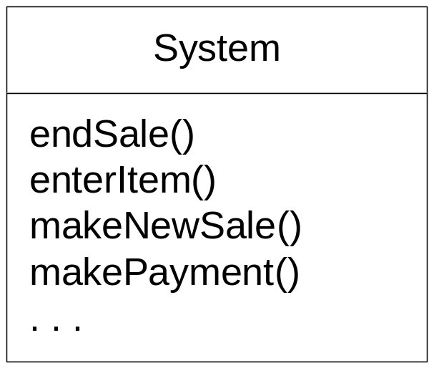
Controller pattern
“System” class: Represents system-level operations
No class called system really
The controller class is assigned responsibility for system-level operations

Slide 42
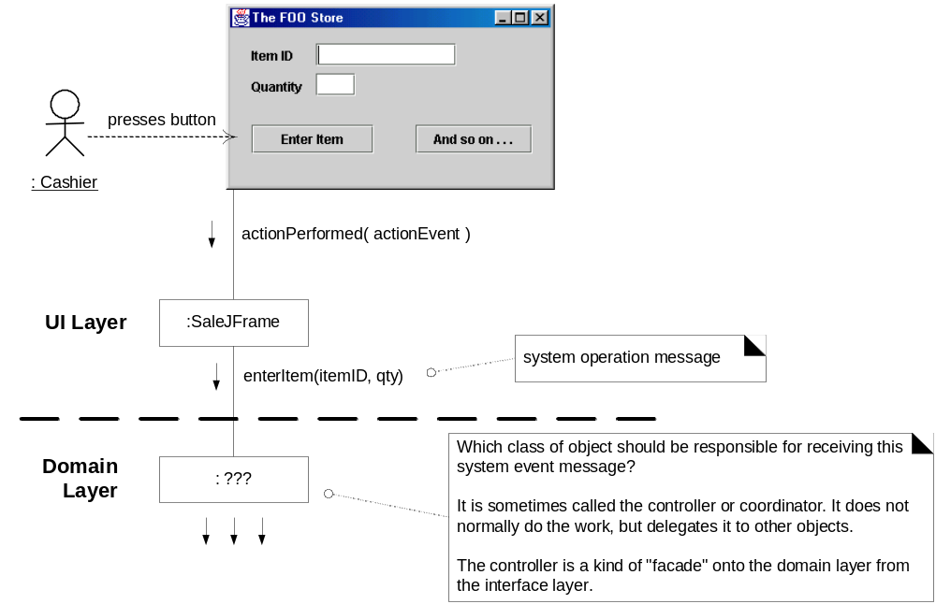
What object should be the Controller for enterItem?

Slide 43
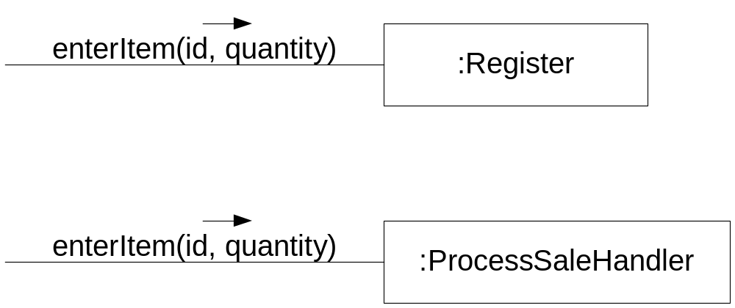
Two controller alternatives

Slide 44
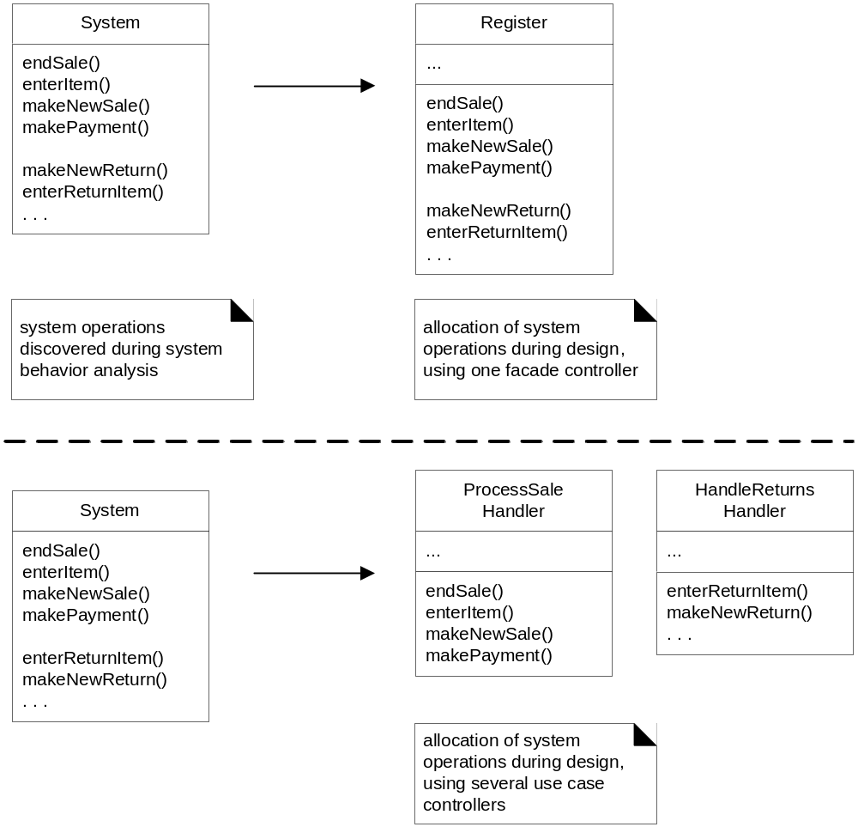
Allocation of system operations to two kinds of controllers

Slide 45
The controller pattern
A delegation pattern
Use same controller class for all system events of one use case
  Controller maintains information about the state of the use case
  Helps identify out-of-sequence operations
    Example: makePayment before endSale
Common defect in design of controllers:
Overassignment of responsibility
  Controller may suffer from low cohesion
Benefits of controller pattern:
  Increased potential for reuse and pluggable interfaces
  Opportunity to reason about the state of the use case

Slide 46
Bloated controllers
Signs of a bloated controller
  There is a single controller receiving many system events
  Controller itself performs the tasks instead of delegating them
  Controller has many attributes, maintains a lot of info about the system or domain
    Better to distribute these to other objects
Cures
  Add more controllers
  Design the controller to delegate the work

Slide 47
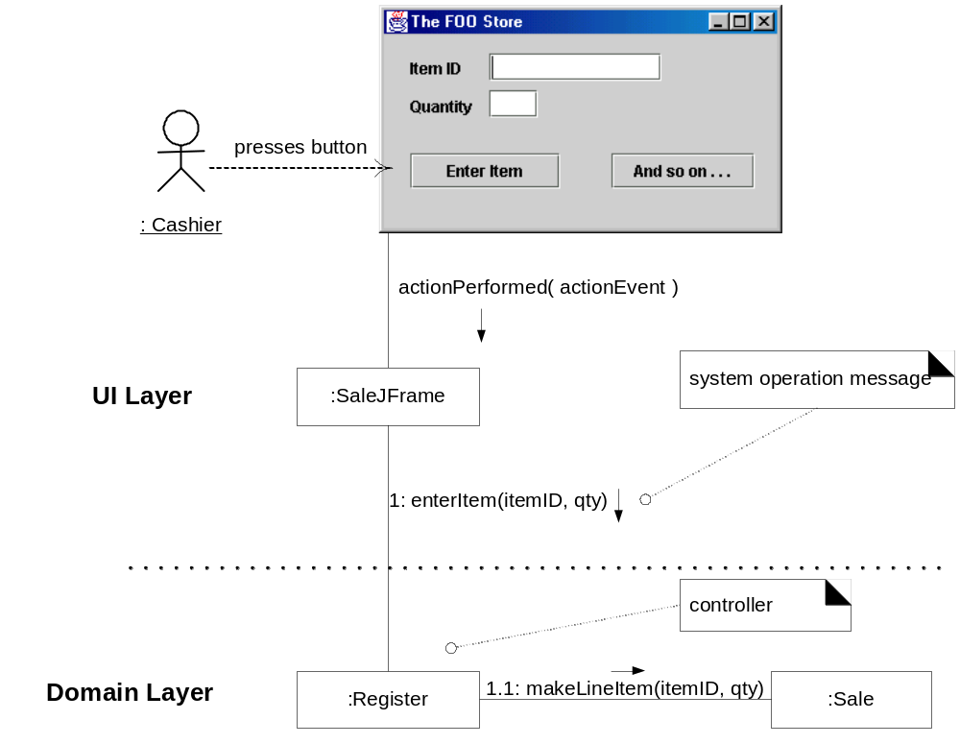
Domain Layer Controller

Slide 48
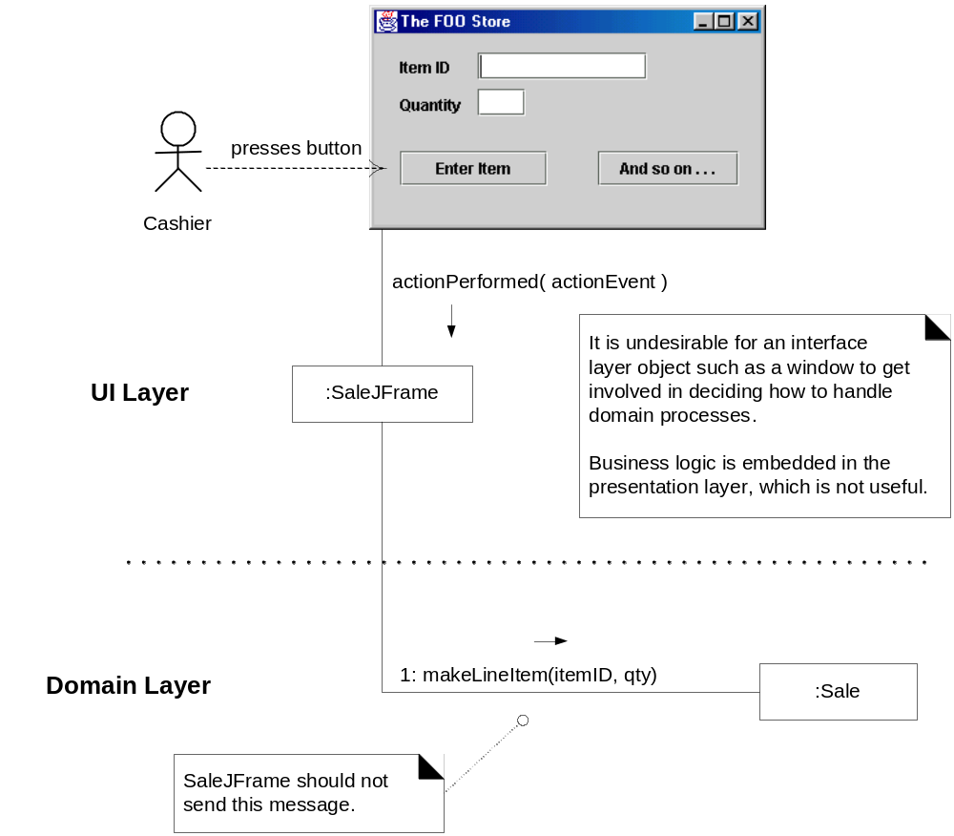
Undesirable: UI Layer object is controller

Slide 49
Swing Example
Code where controller is called
....
public void actionPerformed(ActionEvent e) {
// read itemID and quantity from Swing
// GUI components
...
register.enterItem(itemID, quantity);
}

Slide 50
High Cohesion
Problems with a class with low cohesion:
  Hard to comprehend
  Hard to reuse
  Hard to maintain
  Constantly affected by change

Slide 51
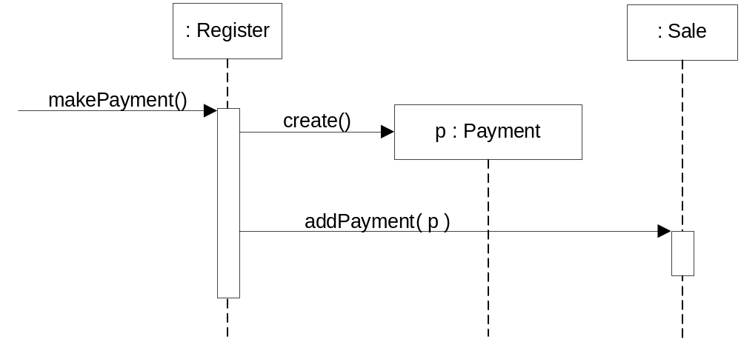
Danger: Register has potential to do too much work

Slide 52
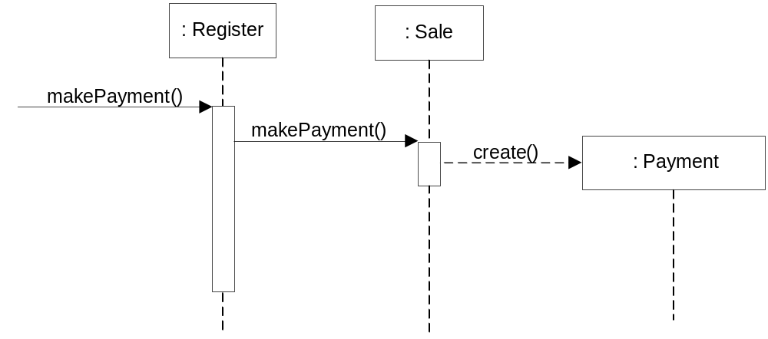
Better design: Register delegates, has high cohesion

Slide 53
Modular Design
Modularity: The property of a system that has been decomposed into a set of cohesive and loosely coupled modules
Exceptions to high cohesion and modularity
  Example: To simplify maintenance by one SQL expert, group all SQL-related functionality of all classes into one separate class
  Distributed server objects: Because of cost of communication, might make sense to have few, large server objects
    Example: Instead of three fine-grained operations, setName, setSalary, setHireDate, have one coarse-grained operation, setData

